Slide 1

Introduction to Expert Systems
Dr. Hatem Magdy

Slide 2
Knowledge
Representation – OAV-SN

Slide 3
OAV Triplet

Slide 4
OAV-Triplets
OAV triplet is concerned with Attribute and Value
of an Object
OAV can be used to characterize the knowledge in a semantic net.
quickly leads to huge tables
Attribute
Object
Value

Slide 5
Object | Attribute | Value
snow | Form-of | water
snow | hardness | soft
ice | temperature | cold
frosty | instance | Snowman
Form-of
snow
water
Engine type
C130
Prop

Slide 6
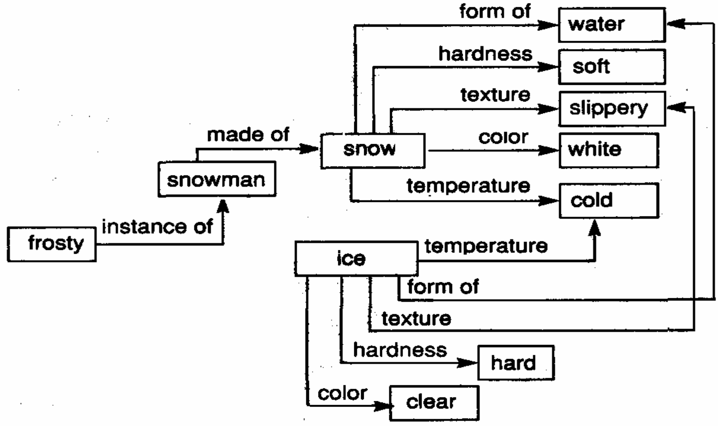
Example: Snow
Directed Graph

Slide 7
Semantic Networks (SN’s)

Slide 8
Semantic nets
Is a graphical representation for propositional information originally developed as a model for human memory labeled, directed graph
nodes represent objects, concepts, or situations
labels indicate the name
nodes can be instances (individual objects) or classes (generic nodes)
links represent relationships
the relationships contain the structural information of the knowledge to be represented
label indicates the type of the relationship
Example: When Timmy woke up and saw snow on the ground, he immediately turned on the radio.

Slide 9
Relationships
without relationships, knowledge is an unrelated collection of facts
reasoning about these facts is not very interesting inductive reasoning is possible
relationships express structure in the collection of facts
this allows the generation of meaningful new knowledge generation of new facts
generation of new relationships

Slide 10
Types of Relationships
relationships can be arbitrarily defined by the knowledge engineer
allows great flexibility
for reasoning, the inference mechanism must know how relationships can be used to generate new knowledge inference methods may have to be specified for every
relationship
frequently used relationships
IS-A
relates an instance (individual node) to a class (generic node)
AKO (a-kind-of)
relates one class (subclass) to another class (superclass)
Made of
Node to another node without info

Slide 11
Objects and Attributes
attributes provide more detailed information on nodes in a semantic network
often expressed as properties
combination of attribute and value
attributes can be expressed as relationships
e.g. has-attribute

Slide 12
Implementation Questions
simple and efficient representation schemes for semantic nets
tables that list all objects and their properties
tables or linked lists for relationships
conversion into different representation methods
predicate logic
nodes correspond variables or constants links correspond to predicates
propositional logic
nodes and links have to be translated into propositional variables and properly combined with logical connectives

Slide 13
Example: Birds
%%% Semantic net knowledge about animals.
%%%%%%%%%%%%%%%%%%%%%%%%%%%%%%%%%%%%%%%%%%%%%%%
canary -- is_a --> bird. canary -- can --> sing. canary -- is --> yellow.
ostrich -- is_a --> bird. ostrich -- not(can) --> fly. ostrich -- is --> tall.
bird -- is_a --> animal. bird -- can --> fly. bird -- has --> wings.
bird -- has --> feathers.
fish -- is_a --> animal.
animal -- can --> breathe. animal -- has --> skin. animal -- can --> move.

Slide 14
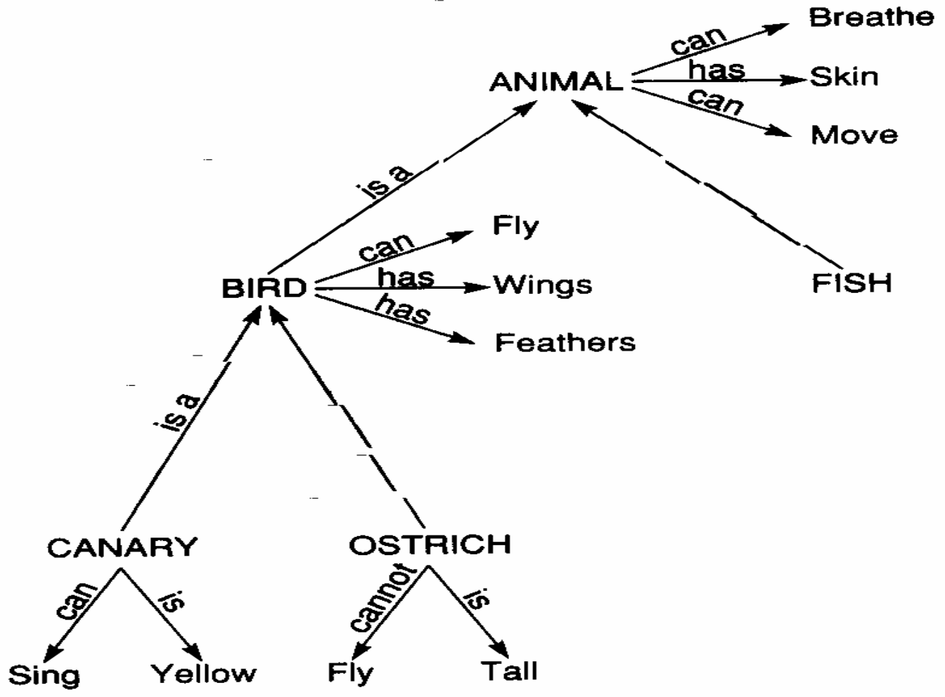
Semantic Nets (SN) & inheritance
SN can be used for data retrieval, also it can provide for deduction
using inheritance
Since a canary is a bird, it inherits the properties of birds (likewise, animals)
e.g., canary can fly, has skin, …

Slide 15

Semantic nets in Prolog
Can define nodes (concepts/objects) as Prolog terms
Can define arcs using operators '--' and '-->' (using not for negative relations)
%%% Semantic net knowledge about animals.
%%%%%%%%%%%%%%%%%%%%%%%%%%%%%%%%%%%%%%%%%%%%%%%
canary -- is_a --> bird. canary -- can --> sing. canary -- is --> yellow.
ostrich -- is_a --> bird. ostrich -- not(can) --> fly. ostrich -- is --> tall.
bird -- is_a --> animal. bird -- can --> fly. bird -- has --> wings.
bird -- has --> feathers.
fish -- is_a --> animal.
animal -- can --> breathe. animal -- has --> skin. animal -- can --> move.

